Slide 1

PANIMALAR ENGINEERING COLLEGE DEPARTMENT OF COMPUTER SCIENCE ENGINEERING 2023-2024 Project Work-CS8811
DETECTION OF THYROID STAGES CLASSIFICATION BY USING CONVENTIONAL NEURAL NETWORK TECHNIQUES
GUIDE
Dr. V. Subedha M.Tech,Ph.D
Professor / CSE
TEAM MEMBERS
A. Samuel Henry Jeyasingh-211420104239
M. Sriram-211420104264
S. Aneesh Ashvat-211420319
Batch-C9

Slide 2
BASE PAPER TITLE
TITLE: DETECTION OF THYROID STAGES CLASSIFICATION BY USING NEURAL NETWORK TECHNIQUES
AUTHOR: Yang Shen , Jinlin Zhu , Zhaohong Deng , Wenwei Lu, and Hongchao Wang, IEEE
TRANSACTION: IEEE/ACM TRANSACTIONS ON COMPUTATIONAL BIOLOGY AND BIOINFORMATICS, VOL. 20, NO. 2, MARCH/APRIL 2023

Slide 3
ABSTRACT
Thyroid disorders are prevalent endocrine diseases affecting millions of people worldwide. The accurate and timely classification of thyroid stages is crucial for effective diagnosis and treatment. In recent years, convolutional neural networks (CNNs) have emerged as a powerful tool for image recognition and classification tasks. The proposed methodology involves a multi-step process. First, a comprehensive dataset of thyroid images representing different stages is compiled and pre-processed for training and validation purposes.
Next, a CNN architecture is designed, comprising multiple layers of convolutions, pooling, and fully connected layers. The model leverages the capability of CNNs to automatically learn and extract relevant features from the input images, making it well-suited for medical image analysis tasks.
The training of the CNN is conducted using a large-scale dataset to optimize its performance and generalization ability. The model is fine-tuned through an iterative process to achieve the highest possible accuracy and precision for thyroid stage classification..
►

Slide 4
EXISTING SYSTEM
A growing number of studies show that the human microbiome plays a vital role in human health and can be a crucial factor in predicting certain human diseases. However, microbiome data are often characterized by the limited samples and high-dimensional features, which pose a great challenge for machine learning methods. Therefore, this system proposes a novel ensemble deep learning disease prediction method that combines unsupervised and supervised learning paradigms.
First, unsupervised deep learning methods are used to learn the potential representation of the sample. Afterwards, the disease scoring strategy is developed based on the deep representations as the informative features for ensemble analysis. To ensure the optimal ensemble, a score selection mechanism is constructed, and performance boosting features are engaged with the original sample. Finally, the composite features are trained with gradient boosting classifier for health status decision. For case study, the ensemble deep learning flowchart has been demonstrated on six public datasets extracted from the human microbiome profiling. The results show that compared with the existing algorithms, our framework achieves better performance on disease prediction.

Slide 5
DISADVANTAGES
They did not implement the deployment process.
They didn’t specific disease particularly because different disease caused by different factors.
They did not do image preprocessing process.
They are using sequential learning approach.

Slide 6
PROPOSED SYSTEM
The proposed system is to develop the project using Deep learning algorithm. Recently, Deep learning and Artificial intelligence has plays a big role in various industries for their improvement and development. So we tried to implement Deep learning algorithm to diagnosis the thyroid. We collected the previous record of patient who had the thyroid and who doesn’t had the disease and those who had symptoms. By collection those peoples information our machine is tried to identifies the pattern of the datasets by various performing calculations.
After identifies the pattern in image using various deep learning algorithm the model can able to predict the instance based on previous information. If you image related to his has given to input then the algorithm can tell whether it is affected or not.

Slide 7
ADVANTAGES
We deploy production level application.
Accuracy and performance measurements are improved.
We specifically classify 4 disease stages.
We compared more than a two architecture to getting better accuracy level.

Slide 8
LITERATURE SURVEY
Title: Thyroid Diagnosis from SPECT Images Using Convolutional Neural Network with Optimization
Author : Liyong Ma , Chengkuan Ma, Yuejun Liu, and Xuguang Wang
Year: 2019
Thyroid disease has now become the second largest disease in the endocrine field; SPECT imaging is important for the clinical diagnosis of thyroid diseases. Since there is little research on the application of SPECT images in the computer-aided diagnosis of thyroid diseases ,a convolutional neural network with optimization-based computer-aided diagnosis of thyroid diseases using SPECT images is developed.
Three categories of diseases are considered, and they are Graves’ disease, Hashimoto disease, and subacute thyroiditis. DenseNet architecture of convolutional neural network is employed and the architecture is modified by adding the trainable weight parameters to each skip connection in DenseNet. The training method is improved by optimizing the learning rate with flower pollination algorithm for network training. Experimental results demonstrate that convolutional neural network is efficient for the diagnosis of thyroid diseases with SPECT images, and it has superior performance than other CNN methods.

Slide 9
LITERATURE SURVEY
Title: A Multi-Scale Densely Connected Convolutional Neural Network for Automated Thyroid Nodule Classification
Author: Luoyan Wang, Xingqing Nie
Year: 2022
Automated thyroid nodule classification in ultrasound images is an important way to detect thyroid nodules and to make a more accurate diagnosis. In this paper, we propose a novel deep convolutional neural network (CNN) model, called n-ClsNet, for thyroid nodule classification. Our model consists of a multi-scale classification layer, multiple skip blocks, and a hybrid atrous convolution (HAC) block.The multi-scale classification layer first obtains multi-scale feature maps in order to make full use of image features. After that, each skip-block propagates information at different scales to learn multiscale features for image classification. Finally, the HAC block is used to replace the downpooling layer so that the spatial information can be fully learned. We have evaluated our n-ClsNet model on the TNUI-2021 dataset. The proposed n-ClsNet achieves an average accuracy (ACC) score of 93.8% in the thyroid nodule classification task.

Slide 10
LITERATURE SURVEY
Title : Artificial Intelligence-Based Thyroid Nodule Classification Using Information from Spatial and
Frequency Domains
Author : Dat Tien Nguyen, Tuyen Danh Pham, Ganbayar Batchuluun, Hyo Sik Yoon
Year : 2019
Image-based computer-aided diagnosis (CAD) systems have been developed to assist doctors in the diagnosis of thyroid cancer using ultrasound thyroid images. However, the performance of these systems is strongly dependent on the selection of detection and classification methods. To address this issue, we propose an artificial intelligence-based method for enhancing the performance of the thyroid nodule classification system.
Thus, we extract image features from ultrasound thyroid images in two domains: spatial domain based on deep learning, and frequency domain based on Fast Fourier transform (FFT). Using the extracted features, we perform a cascade classifier scheme for classifying the input thyroid images into either benign (negative) or malign (positive) cases. Through the thyroid digital image database (TDID) dataset, we show that our proposed method outperforms the state-of-the-art methods and produces up-to-date classification results for the thyroid nodule classification problem.

Slide 11
LITERATURE SURVEY
Title : Multi-channel convolutional neural network architectures for thyroid cancer detection
Author : Xinyu Zhang , Vincent C. S. Lee , Jia RongI , Feng Liu , Haoyu Kong
Year : 2022
Early detection of malignant thyroid nodules leading to patient-specific treatments can reduce morbidity and mortality rates. With the emergence of deep learning, advances in computer-aided diagnosis techniques have yielded promising earlier detection and prediction accuracy; however, clinicians’ adoption is far lacking. The present study adopts Xception neural network as the base structure and designs a practical framework, which comprises three adaptable multi-channel architectures that were positively evaluated using real-world data sets. The proposed architectures outperform existing statistical and machine learning techniques and reached a diagnostic accuracy rate of 0.989 with ultrasound images and 0.975 with computed tomography scans through the single input dual-channel architecture. Moreover, the patient-specific design was implemented for thyroid cancer detection and has obtained an accuracy of 0.95 for double inputs dual-channel architecture and 0.94 for four-channel architecture. Our evaluation suggests that ultrasound images and computed tomography (CT) scans yield comparable diagnostic results through computer-aided diagnosis applications. Besides, with the proposed framework, clinicians can select the best fitting architecture when making decisions regarding a thyroid cancer diagnosis. The proposed framework also incorporates interpretable results as evidence, which potentially improves clinicians’ trust and hence their adoption of the computer-aided diagnosis techniques proposed with increased efficiency and accuracy.

Slide 12
LITERATURE SURVEY
Title : Using deep convolutional neural networks for multi-classification of thyroid tumour by histopathology: a large-scale pilot study
Author : Yunjun Wang , Qing Guan , Iweng Lao , Li Wang , Yi Wu , Duanshu Li , Qinghai Ji , Yu Wang , Yongxue Zhu , Hongtao Lu , Jun Xiang
Year : 2019
The large scale pilot study of multi-classification of thyroid by histopathological slides using Deep Convolutional Neural Networks (DCNN’s) is an attempt made by thyroid specialists to improve the efficiency of diagnosis of various thyroid stages. Thyroid diseases are divided into benign tumours and malignant tumours. The pathological types of Thyroid are difficult to identify and follow-ups are often required for benign tumours for which this study of using DCNN’s was undertaken by the Chinese Thyroid Cancer Centre in Fudan. For this research, the CNN’s VGG-19 and Resnet-V2 were used and divided into training datasets and test datasets. From the test datasets, VGG-19 proved to have better diagnostic efficiency of 97% than Resnet-V2 which had an efficiency of 94%. The VGG-19 model was able to identify 7 pathology types of thyroid such as nodular goitre, adenoma, papillary, follicular, medullary, and anaplastic carcinomas providing excellent diagnostic qualities for each type, except the normal tissue and adenoma which were challenging histological types for the VGG-19 to identify. Hence, it was concluded that DCNN’s had immense abilities to identify histopathologic thyroid disease diagnosis.

Slide 13
LITERATURE SURVEY
Title : Expert System Based On Neural-Fuzzy Rules for Thyroid Diseases Diagnosis
Author : Ahmad Taher Azar1,3, IEEE Senior Member, Aboul Ella Hassanien
Year : 2014
The Expert System based on Neural Fuzzy Rules used the Linguistic Hedges Neural Fuzzy Classifier with Selected Features (LHNFCSF) method for thyroid diagnosis. The Thyroid gland secretes hormones which is circulated to all the tissues in the body. It’s main function is to regulate various parts of our body such as brain, heart, tissues, muscles and reproductive organs by secreting hormones in the Thyroid gland and controlling the metabolism rate. The LHNFCSF used the classification accuracy and the k-fold cross evaluation approaches for performance evaluation. Without the feature selection, the classification accuracy showed 98% and 97% in training and testing phases respectively. Using feature selection, it showed 100% efficiency. There are two common types of thyroid disorders are hypothyroidism and hyperthyroidism where hypothyroid is poor secretion of thyroid hormone and hyperthyroid is excess secretion of thyroid hormones. Goitres are also a huge problem in thyroid which can be removed only through surgery. Various new methods such as Artificial Neural Networks, Linear Discriminant Analysis (LDA), Decision trees, Fuzzy expert systems and also Feature Selection methods. The classifier method is used to give a very fast, easy and efficient Computer Aided Design (CAD). Hence, it was concluded that the classification accuracy approach was very efficient in comparison to other application methods to classify the various thyroid diseases.

Slide 14
LITERATURE SURVEY
Title : Diagnosis of hypothyroidism using a fuzzy rule-based expert system
Author : Negar Asaad Sajadia, Shiva Borzoueib, Hossein Mahjubc, Maryam Farhadianc,∗
Year : 2019
The thyroid gland is an endocrine gland that is shaped like a butterfly and plays numerous roles to regulate the metabolic processes in the body. Deficiency in thyroid causes hypothyroidism which is found commonly amongst pregnant women, whereas, the excess secretion of thyroid causes hyperthyroidism. Therefore, timely diagnosis is very important for thyroid disorders. The diagnosis of hypothyroidism using a fuzzy rule-based expert system was performed by referring patients to Imam Khomeini Clinic and Shahid Behesti Hospital. A total of 305 patients were selected as test subjects for the experiment of diagnosing thyroid disorders by designing a fuzzy rule-based classifier expert system. This model’s predictive performance was compared to that of a multinomial logistic regression model in terms of accuracy, sensitivity and specificity. Various machine learning methods such as neural networks, fuzzy logic, support vector machine (SVM) have been developed recently to solve many complex problems in the medical area. Fuzzy if-then rule-based expert systems are one of the most practical intelligent models with the high potential for managing uncertainty associated to the medical diagnosis. Zadeh (1965) introduced the theory of fuzzy sets. Thus, it was concluded that the fuzzy rule based classifier used overlapping sets that has improved the classification efficiency and decision making processes for detecting the thyroid diseases.

Slide 15
LITERATURE SURVEY
Title : A Study of Neural Network in Diagnosis of Thyroid Disease
Author : Astha Rastogi , Monika Bhalla
Year : 2019
The thyroid gland is one of the most important gland in the human body. The main function of the thyroid gland is to regulate the metabolism rate of the human body. This gland makes two active hormones levothyroxine (T4) and triiodothyronine (T3). Majority of the population affected by thyroid disorders are women and elderly people all around the world. Carelessness of this disease may even lead to death in a number of cases. The various symptoms of thyroid are lethargy, weight gain and poor memory. Artificial Neural Networks have powerful classification pattern and recognition ability for identifying the thyroid disorders. Neural network methods are more data driven as compared to traditional methods. Neural networks have generalization ability which means they have the ability to identify the pattern correctly after the data is provided to it. They divide the data into training samples and test samples. The training model is used for neural network model building and the test model is used to evaluate the predictive capability of the model. It was concluded that the neural networks uses multiple random training and test subsamples. The advantage of cross validation is that all of the observations or patterns in the available sample are used for testing and many of them are also used for training the model.

Slide 16
LITERATURE SURVEY
Title : An Intelligent System for Diagnosing Thyroid Disease in Pregnant Ladies through Artificial Neural Network
Author : Vimal Kamleshkumar Bhatta, Vinod Kumar Palb
Year : 2019
Thyroid diseases have become one of the most common prevailing problems amongst pregnant women. Almost 70% of pregnant women are diagnosed with thyroid diseases. To reduce this, Decision Systems in medical sciences have been developed to provide the output of any disease. The causing factors of any disease are used as inputs and using these input values, a decision is made using the Artificial Neural Network (ANN). The ANN first trains the model based on the given training data sets and predicts the presence of a disease. This method is used with other prediction methods such as Multiple Regression and Random Forest out of which ANN has the highest accuracy rate of 98% whereas Multiple Regression was 2% and Random Forest was 22%. The Artificial Neural Network diagnoses the levels of TSH, T3 and T4 which are important thyroid secretion hormones in the thyroid gland and predicts the disease. The levels of T3,T4 and TSH in pregnant women have also been analysed and is considered to be well efficient in diagnosis of the thyroid disease. The future scope of this project is found to have integration of ANN with various decision making systems and to be faster, efficient and accurate in providing patients with optimal and specific single line treatment.

Slide 17
LITERATURE SURVEY
Title : Thyroid Disease Classification Using Machine Learning Algorithms
Author : Khalid salman , Emrullah Sonuc
Year : 2021
With the growing amount of data and information in the medical field, diagnosis of diseases are done using machine learning algorithms and data mining techniques. The objective of this project is to detect the presence of thyroid disease using machine learning. For this, a group of Iraqi people with various thyroid diseases such as hypothyroidism which causes obesity, low heart rate, increased temperature sensitivity, neck swelling, hand numbness, hair issues and hyperthyroidism which causes dry skin, hair thinning, weight loss, increased heart rate, high blood pressure, heavy sweating, neck enlargement, nervousness, menstrual cycles shortening, irregular stomach movements and hands shaking were selected and were diagnosed using various machine learning techniques such as vector machines, random forest, decision tree, naïve bayes, logistic regression, k-nearest neighbours, multilayer perceptron (MLP), linear discriminant analysis. Machine learning is one of the best techniques to solve difficult problems. Classification is a machine learning technique which is used to classify the data and provides high performance. Even though computer learning methods are outdated, there is a new demand for machine learning healthcare solutions for which analysts predict that it will become a common technique in the field of healthcare.

Slide 18
LITERATURE SURVEY
Title : Machine Learning Techniques for Thyroid Disease Diagnosis – A Review
Author : Shaik Razia1 and M. R. Narasinga Rao
Year : 2016
Thyroid is a complex disease which is caused due to uneven Thyroid Stimulating Hormones (TSH). The most common thyroid is hypothyroidism also known as hashimoto’s thyroid. It is an autosave condition where the body makes antibodies of its own to pulverize the thyroid organ. The neural network models which describe the aspects related non functionality of thyroid gland, its autoimmune condition and different aspects of thyroid disease have been explored. Thyroid sickness finding was done with different Neural Networks with various enactment capacities for comparing the performance of the networks. Proposed machine learning strategy including simulated insusceptible acknowledgment framework which is an arrangement framework to analyse the thyroid issue. One of the most noticeable and broadly utilized neural systems which go under the classification of feed forward neural systems, are outspread premise capacity systems, Bayesian systems, fuzzy neural systems, back propagated neural systems, stream based systems. Learning should be possible in two ways - Supervised Learning and Unsupervised Learning. Results showed that neural networks had best and accurate results with 85% efficiency in diagnosing thyroid dysfunctions. The drawback is that we need a variable determination technique for up to 20% in case of a large number of characteristics.

Slide 19
LITERATURE SURVEY
Title : Application of machine learning algorithms to predict the thyroid disease risk: an experimental comparative study
Author : Saima Sharleen Islam , Md. Samiul Haque , M. Saef Ullah Miah , Talha Bin Sarwar and Ramdhan Nugraha
Year : 2022
The thyroid deficiency is currently one of the most dangerous and difficult to diagnose. They affect almost groups of people from children, men, women and elderly too. They are usually detected using blood tests but are very difficult to diagnose because of large amount of data. To solve this, the study uses eleven machine learning techniques to determine which technique produces the best accuracy for detecting the thyroid disorder. This study uses a technique called as Sick- euthyroid obtained from the University of California, Irvine’s machine learning repository for the purpose of thyroid detection. However, this method was not successful because the target variable classes in the dataset are mostly one. However, each research is difficult to understand due to the massive amount of data needed to anticipate results. Alqurashi & Wang (2019) used different clustering algorithms to create an adaptive clustering ensemble model to predict thyroid illness. They used association rule mining methods to assess the datasets. They found an AUC of 94.58% using the ROC curve. This study examines multiple machine learning algorithms, including CatBoost, ExtraTrees, ANN, LightGBM, SVC, KNN, Random Forest etc. The performance of several algorithms is then compared. Thus the conclusion of the research is a summary of the entire work.

Slide 20
LITERATURE SURVEY
Title : THYROID DETECTION USING MACHINE LEARNING
Author : Chandan R, Chetan Vasan, Chethan MS,Devikarani H S
Year : 2021
The Thyroid gland is a vascular gland which is used to regulate the various metabolisms in the body. The two major types of thyroid disorders are hypothyroidism and hyperthyroidism which occurs when there is an imbalance level in the thyroid secreting hormones (TSH). To detect thyroid disease, blood tests are taken but they are not efficient as there is too much blood and noise. Hence the machine learning algorithms have started playing a crucial role in resolving the complex and non-linear problems in the developing model. The thyroid hormones are useful in counting how briskly the heart beats and how fast we burn calories. The thyroid secretes two types of active hormones called levothyroxine (T4) and triiodothyronine (T3) These hormones help in regulating the body temperature. Machine Learning plays a very deciding role in the disease prediction. Machine Learning algorithms, SVM Support Vector Machine, decision tree, logistic regression, K-nearest neighbours, Artificial Neural Network are used to predict the patient’s risk of getting thyroid disease. Thyroid Detection using Machine Learning is a project idea that aims a smart and precise way to predict thyroid disease. In conclusion the machine is trained to detect whether the person is normal, hyper or hypo based on the user’s input.

Slide 21
LITERATURE SURVEY
Title : THYROID CANCER DETECTION USING MACHINE LEARNING TECHNIQUES
Author : R.Vanitha, Dr. K. Perumal
Year : 2022
In recent times of Digital and Technology, the number of diseases are increasing at a high rate. It is also a fact that Thyroid disorders are the second most common endocrine disorders in the world according to World Health Organization (WHO). Hypothyroidism and Hyperthyroidism are the two most common thyroid disorders existing in India. Hypersecretion of thyroxine also known as Hyperthyroidism affects about 2% of individuals, while hyposecretion of thyroxine in Hypothyroidism affects about 1% of individuals. Both these disorders may be mostly caused by thyroid gland dysfunction. The diagnosis process for thyroid detection is difficult and is not accurate, However, machine learning techniques are often useful for accurate prediction and diagnosis of thyroid disorders. This research emphasizes on analysing with Machine Learning techniques like Naïve Bayes, logistic regression, K-Neighbour Support Vector Machine, Decision Tree Classifier, Artificial Neural Network and AdaBoost classifier, Logistic regression and Support Vector Machine classifier. The Analysis of all the four algorithms ended up with better prediction than human intervention resulting in SVM with best prediction with the data set preceded. Machine Learning classification algorithms are used to identify the thyroid difficulties. Machine Learning algorithms such as KNN, Naïve bayes, Support vector machine are measured for the study. The results are that SVM is 92.53, logical regression is 91.73 and Decision tree is 90.13 and if the data set is greater, the computational cost of SVM will rise.

Slide 22
LITERATURE SURVEY
Title : Prediction of Thyroid Disease Using Machine Learning Techniques
Author : Pothamsetty Pavani, Dr.P.P.Sadu Naik
Year : 2022
Thyroid disorders are one of the most leading complications in the field of healthcare and do not have accurate prediction or diagnosis for proper treatment. Thyroid hormones are responsible for regulating the body’s metabolism rate. For early-stage disease detection, various intelligent prediction algorithms are used. The reality of forecasting any condition associated with thyroid illness is also of the greatest cardinal number. Machine learning algorithms play an important role in solving complex and non-linear problems during the creation of the prediction model. The characteristics of the datasets can be used as description in a healthy patient as specifically as possibly needed in any disease prediction models. The machine learning is critical in the disease prediction process and in the study and classification models used for thyroid disease on the basis of data obtained from hospital datasets. Basic techniques of machine learning are used for the identification and inhibition of thyroid. The SVM is used to predict the approximate probability of a thyroid patient. In recent years, numerous approachable analyses for adequate and professional diagnosis of thyroid disease have been detected using various machine learning techniques. On the other hand, the help vector machine and decision tree have done well. Thus, it came to a conclusion that certain algorithms and predictive models of thyroid disease need to be developed those that requires a minimum number of criteria for person to diagnose thyroid disease and saving patient's time and money.

Slide 23
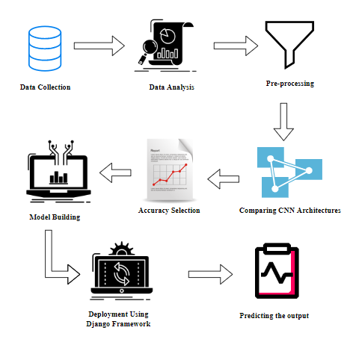
SYSTEM ARCHITECTURE

Slide 24
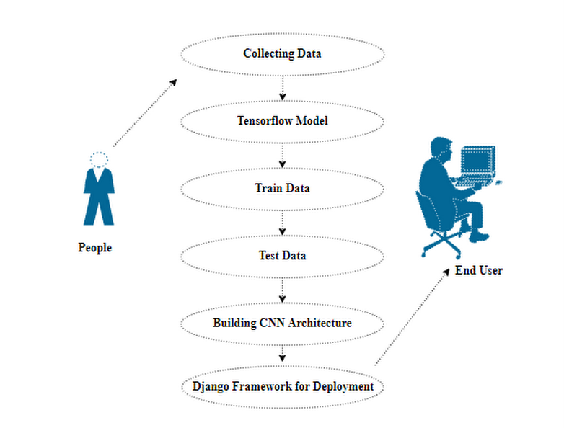
USECASE DIAGRAM

Slide 25
MODULES
1. MANUAL NET
2. XCEPTION NET
3.DENCENET
4. DEPLOY

Slide 26
MODULE DESCRIPTION
IMPORT THE GIVEN IMAGE FROM DATASET:
We have to import our data set using keras preprocessing image data generator function also we create size, rescale, range, zoom range, horizontal flip. Then we import our image dataset from folder through the data generator function. Here we set train, test, and validation also we set target size, batch size and class-mode from this function we have to train using our own created network by adding layers of CNN.
TO TRAIN THE MODULE BY GIVEN IMAGE DATASET:
To train our dataset using classifier and fit generator function also we make training steps per epoch’s then total number of epochs, validation data and validation steps using this data we can train our dataset.

Slide 27
MODULE DESCRIPTION
WORKING PROCESS OF LAYERS IN CNN MODEL:
A Convolutional Neural Network (ConvNet/CNN) is a Deep Learning algorithm which can take in an input image, assign importance (learnable weights and biases) to various aspects/objects in the image and be able to differentiate one from the other. The pre-processing required in a ConvNet is much lower as compared to other classification algorithms. While in primitive methods filters are hand-engineered, with enough training, ConvNets have the ability to learn these filters/characteristics. The architecture of a ConvNet is analogous to that of the connectivity pattern of Neurons in the Human Brain and was inspired by the organization of the Visual Cortex. Individual neurons respond to stimuli only in a restricted region of the visual field known as the Receptive Field. Their network consists of four layers with 1,024 input units, 256 units in the first hidden layer, eight units in the second hidden layer, and two output units.
Input Layer:
Input layer in CNN contain image data. Image data is represented by three dimensional matrixes. It needs to reshape it into a single column. Suppose you have image of dimension 28 x 28 =784, it need to convert it into 784 x 1 before feeding into input.

Slide 28
MODULE DESCRIPTION
Convo Layer:
Convo layer is sometimes called feature extractor layer because features of the image are get extracted within this layer. First of all, a part of image is connected to Convo layer to perform convolution operation as we saw earlier and calculating the dot product between receptive field (it is a local region of the input image that has the same size as that of filter) and the filter. Result of the operation is single integer of the output volume. Then the filter over the next receptive field of the same input image by a Stride and do the same operation again. It will repeat the same process again and again until it goes through the whole image. The output will be the input for the next layer.

Slide 29
MODULE DESCRIPTION
Pooling Layer:
Pooling layer is used to reduce the spatial volume of input image after convolution. It is used between two convolution layers. If it applies FC after Convo layer without applying pooling or max pooling, then it will be computationally expensive. So, the max pooling is only way to reduce the spatial volume of input image. It has applied max pooling in single depth slice with Stride of 2. It can observe the 4 x 4 dimension input is reducing to 2 x 2 dimensions.
Fully Connected Layer (FC):
Fully connected layer involves weights, biases, and neurons. It connects neurons in one layer to neurons in another layer. It is used to classify images between different categories by training.

Slide 30
MODULE DESCRIPTION
Softmax / Logistic Layer:
Softmax or Logistic layer is the last layer of CNN. It resides at the end of FC layer. Logistic is used for binary classification and softmax is for multi-classification.
Output Layer:
Output layer contains the label which is in the form of one-hot encoded. Now we have a good understanding of CNN.

Slide 31
MODULE DESCRIPTION
Dense Connectivity: DenseNet introduces dense connections between layers, where each layer is connected to all preceding and subsequent layers in a feed-forward manner. This means that the feature maps from all previous layers are concatenated and fed as inputs to the current layer. This dense connectivity creates a very deep network, which improves feature reuse and information flow through the network.
Growth Rate: DenseNet controls the number of feature maps learned in each layer through a parameter called the growth rate. The growth rate determines how many new feature maps are added to each layer concerning the number of input feature maps. It acts as a form of bottleneck, allowing the network to stay more compact and efficient.
Transition Layers: In DenseNet, transition layers are used to control the spatial dimensions and reduce the number of feature maps before feeding them into the next dense block. These transition layers typically consist of a batch normalization layer, a 1x1 convolutional layer, and an average pooling layer. The average pooling layer reduces the spatial dimensions, while the 1x1 convolutional layer reduces the number of feature maps, thereby compressing the information.

Slide 32
MODULE DESCRIPTION
Batch Normalization and ReLU: DenseNet employs batch normalization and ReLU activation functions after each convolutional layer. Batch normalization helps in stabilizing and accelerating the training process by normalizing the input to each layer, while ReLU introduces non-linearity and helps in capturing more complex patterns in the data.
Dense Blocks: DenseNet is composed of multiple dense blocks, where each dense block consists of multiple densely connected layers. These dense blocks are connected by transition layers, as mentioned earlier. The architecture can have different configurations based on the depth and complexity needed for a specific task.
DenseNet has gained popularity due to its efficient use of parameters, better feature propagation, and strong performance in image classification tasks, even with relatively smaller datasets. It addresses some of the challenges faced by traditional deep networks, such as vanishing gradients, and has achieved state-of-the-art results on various benchmark datasets.

Slide 33
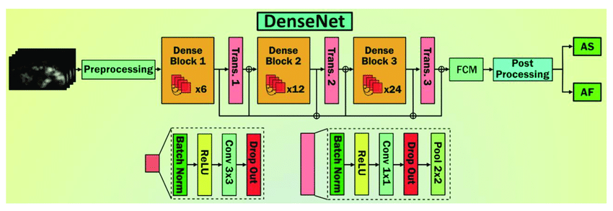
MODULE DESCRIPTION

Slide 34
MODULE DESCRIPTION
2. LENET:
The LeNet architecture is a pioneering convolutional neural network (CNN) architecture developed by Yann LeCun and his colleagues in the early 1990s. It played a crucial role in the advancement of deep learning and was specifically designed for handwritten digit recognition tasks, such as recognizing digits in checks and postal addresses. LeNet laid the foundation for modern CNNs and their applications in image recognition and computer vision tasks.
The LeNet architecture consists of the following layers:
Input Layer: This layer accepts the input image, which is typically a grayscale image of a handwritten digit. The input images are usually of size 32x32 pixels.
Convolutional Layers: LeNet uses two convolutional layers to extract features from the input images. Each convolutional layer applies convolutional filters (also called kernels) to the input image, capturing different patterns and features. These filters slide over the image to create feature maps.
Subsampling (Pooling) Layers: After each convolutional layer, a subsampling layer (also known as a pooling layer) is applied to reduce the spatial dimensions of the feature maps and help in retaining important information while reducing computation.

Slide 35
MODULE DESCRIPTION
Fully Connected Layers: The subsampled feature maps are then flattened and passed through fully connected layers, which are traditional neural network layers. These layers are responsible for making classification decisions based on the extracted features.
Output Layer: The final fully connected layer produces the output of the network, which represents the predicted class probabilities. For handwritten digit recognition, this would typically involve 10 output nodes, each corresponding to a digit class (0 to 9).
LeNet was designed before the deep learning era as we know it today, so it has fewer layers compared to modern architectures like ResNet, VGG, or Inception. However, its fundamental design principles, including the use of convolutional and pooling layers, inspired the development of more complex CNN architectures. LeNet demonstrated the potential of neural networks in handling image recognition tasks and played a pivotal

Slide 36
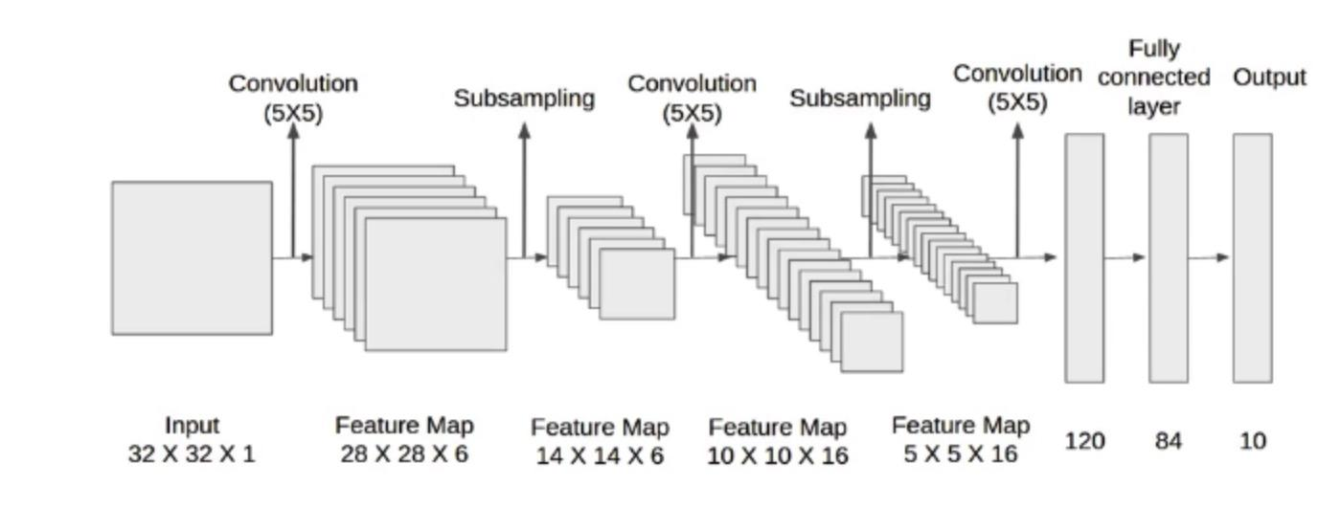
MODULE DESCRIPTION

Slide 37
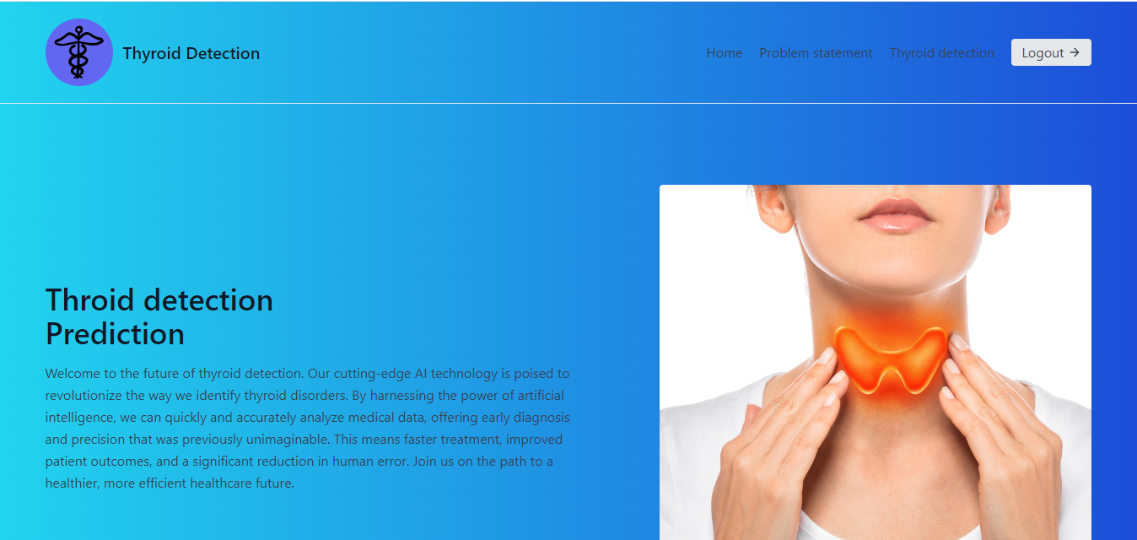
OUTPUT SCREENSHOTS

Slide 38
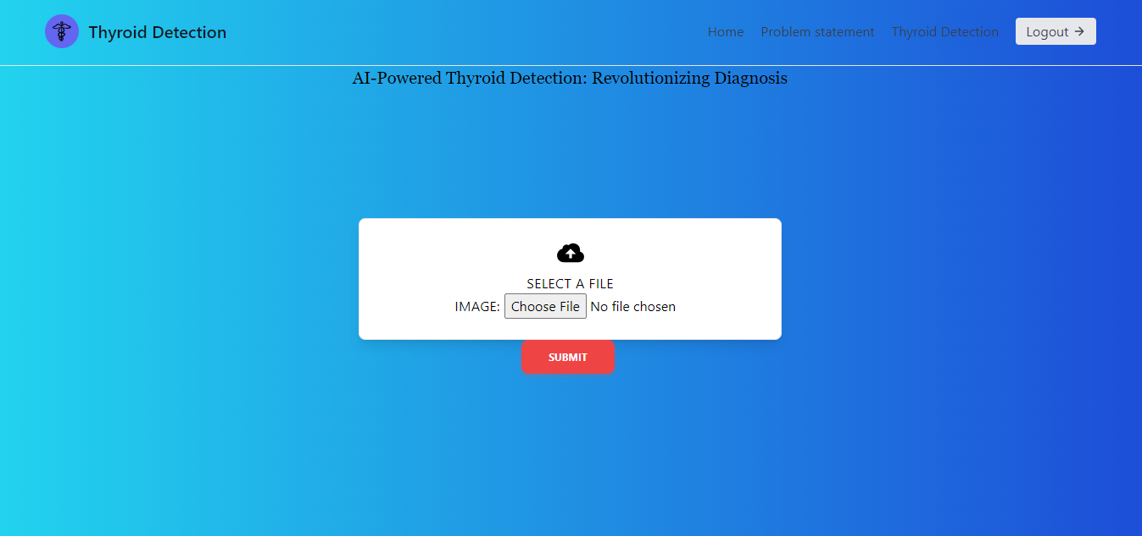
OUTPUT SCREENSHOTS

Slide 39
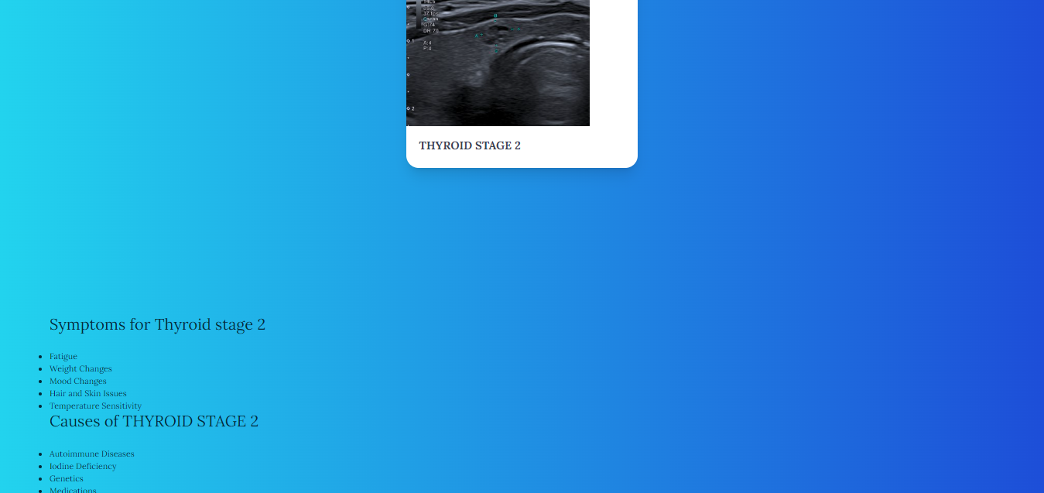
OUTPUT SCREENSHOTS

Slide 40
CONCLUSION
In conclusion, our research project represents a significant step forward in the field of thyroid disorder diagnosis. By successfully developing and implementing a Convolutional Neural Network-based system, we have unlocked the potential for accurate, efficient, and ethical thyroid stage classification.
This work not only benefits healthcare professionals but also holds promise for improving the lives of individuals affected by thyroid disorders. As we move forward, we remain committed to ongoing collaboration, refinement, and further advancements in this critical area of medical technology

Slide 41
FUTURE ENHANCEMENT
Future enhancement would involve more optimization on hyperparameters and model aspects such as which layers to freeze versus make trainable during transfer learning. Due to computing resource and time constraints, most model implementation decisions were made by examining the convergence of the model and relative metrics from training versus validation, but an exhaustive hyper parameter search would have been a more empirical approach.

Slide 42
REFERENCES
[1] P. J. Turnbaugh et al., “The human microbiome project,” Nature, vol. 449, no. 7164, pp. 804–810, 2007.
[2] J. C. Wooley, A. Godzik, and I. Friedberg, “A primer on metagenomics,” PLoS Comput. Biol., vol. 6, no. 2, 2010, Art. no. e1000667.
[3] I. Cho and M. J. Blaser, “The human microbiome: At the interface of health and disease,” Nature Rev. Genet., vol. 13, no. 4, pp. 260–270, 2012.
[4] C. Manichanh et al., “The gut microbiota in IBD,” Nature Rev. Gastroenterol. Hepatol., vol. 9, no. 10, pp. 599–608, 2012.
[5] R. E. Ley et al., “Human gut microbes associated with obesity,” Nature, vol. 444, no. 7122, pp. 1022–1023, 2006.
[6] T. Zhu and M. O. Goodarzi, “Metabolites linking the gut microbiome with risk for type 2 diabetes,” Curr. Nutr. Rep., vol. 9, no. 2, pp. 83–93, 2020.

Slide 43
[7] I. Dickson, “Microbiome signatures for cirrhosis and diabetes,”
Nature Rev. Gastroenterol. Hepatol., vol. 17, no. 9, pp. 532–532, 2020.
[8] E. Saus et al., “Microbiome and colorectal cancer: Roles in carcinogenesis and clinical potential,” Mol. Aspects Med., vol. 69, pp. 93–106, 2019.
[9] W. S. Garrett, “Cancer and the microbiota,” Science, vol. 348, no. 6230, pp. 80–86, 2015.
[10] M. A. Malla et al., “Exploring the human microbiome: The potential future role of next-generation sequencing in disease diagnosis and treatment,” Front. Immunol., vol. 9, 2019, Art. no. 2868

